Slide 1

EMPLOYEE MAANGEMENT SYSTEM
MADE BY:- STUTI PATEL [18BECE30170]
VIREN ZALAVADIYA [18BECE30179]
GUIDED BY: Proff.Riya Gohil

Slide 2
ABSTRACT
This project aims at creating an Online Employee Management system which can be used by the employess working in any organization.
Employees can enter their data/information which is necessary for an organization.
The users/employees can register and log into the system.
The administrator will know the details of each employees entering their data and the one which is admin can edit the data.

Slide 3
SYSTEM DEFINATION
A Employee’s Management System (EMS) is a software built to handle the primary functions of a company.
EMS help companies keep track of all the employees and their records.
It is used to manage the company using computerized system.

Slide 4
ADVANTAGES OF SYSTEM
Efficiency And Better Accuracy
Fewer Compliance Risks
Boosted Profitability
Very Few Manual Errors
Higher Productivity
Higher Motivation
Lower Costs

Slide 5
SYSTEM ANALYSIS
In the Employee Management System we analysed that both the admin/administrator and the employees can enter the data.
But only administrator have the right to edit the entered data by the employees.
None of the employees can edit or delete their entered information.

Slide 6
USER MODULE
Employees have to enter the data like name,
E-mail ID, date of joining, department etc.
They Can login with his/her own user id and password.
The employees can see their projects and tasks given by their higher authorities.
They Can regenerate password if he/she forgets the password.
The Employees can not edit their information once entered.

Slide 7
ADMINISTRATOR MODULE
Admin/Administrator can login by their user id or user name and password.
They can assign the tasks to employees.
They can also regenerate their user name and password if they have forgotten.
Administrator can make changes in the data entered by all the emplpoyees.

Slide 8
DESIGN CONSTRAINTS
SOFTAWRE CONSTRAINTS
HARDWARE CONSTRAINTS
OPERATING SYSTEM – WINDOWS/LINUX
PLATFORM – PHP, JS, CSS, HTML
WEB SERVER – Internet Information Server[IIS]
PROCESSOR – INTEL CORE i5 7th Gen
RAM – 8 GB RAM
1TB HDD

Slide 9
UML DIAGRAMS
The Unified Modeling Language (UML) is a standard language for specifying, visualizing, constructing, and documenting the artifacts of software systems, as well as for business modeling and other non-software systems
The UML uses graphical notations to express the design of software projects

Slide 10
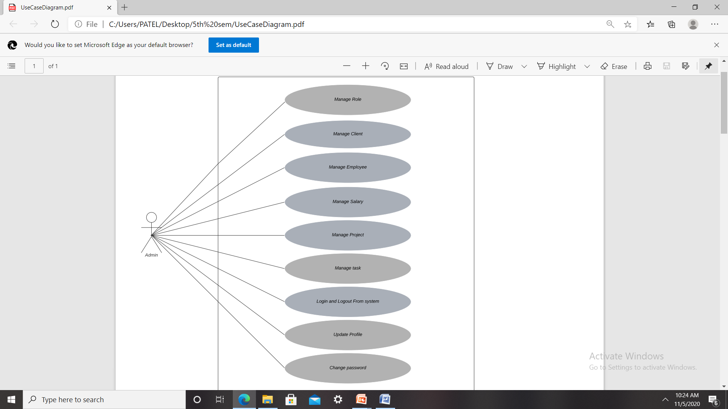
USE CASE DIAGRAM FOR THE USER

Slide 11
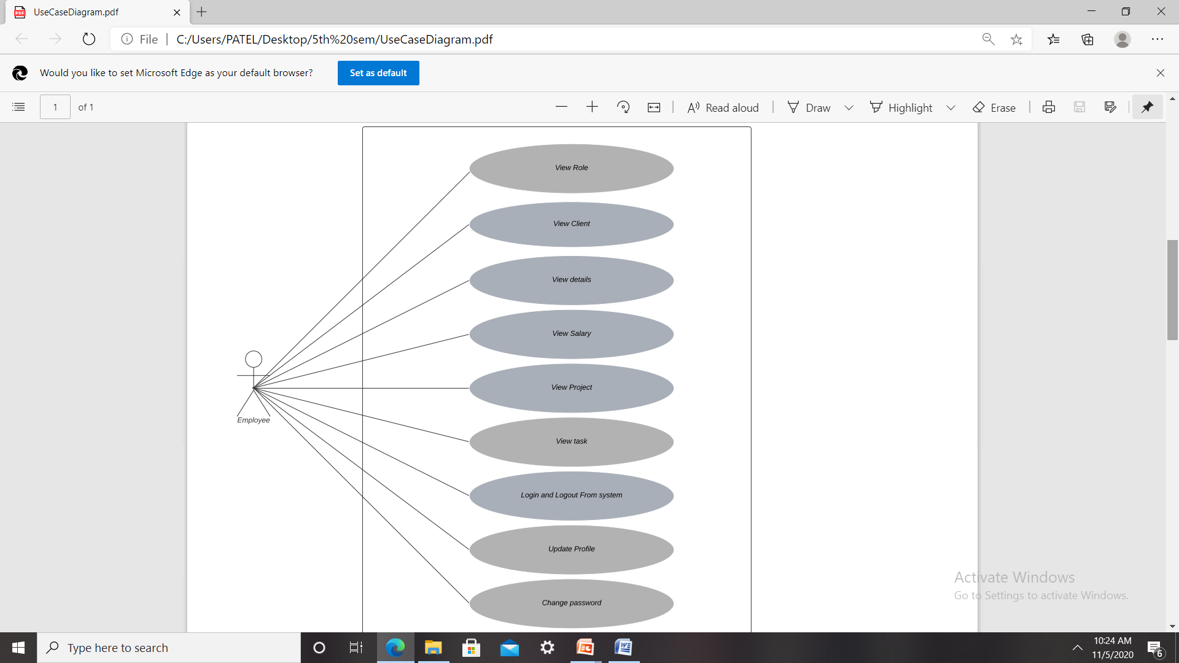

Slide 12
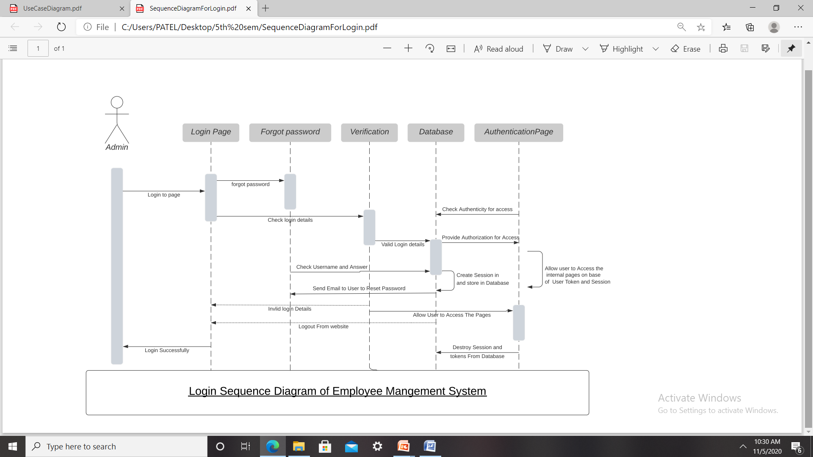
SEQUENCE DIAGRAM FOR LOGIN

Slide 13
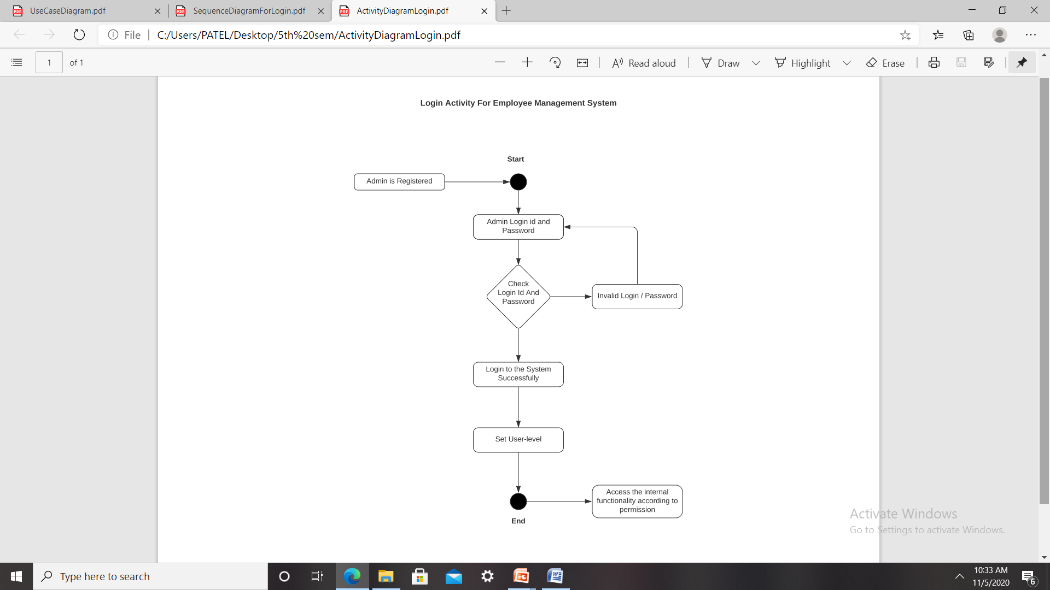
ACTIVITY DIAGRAM FOR LOGIN

Slide 14
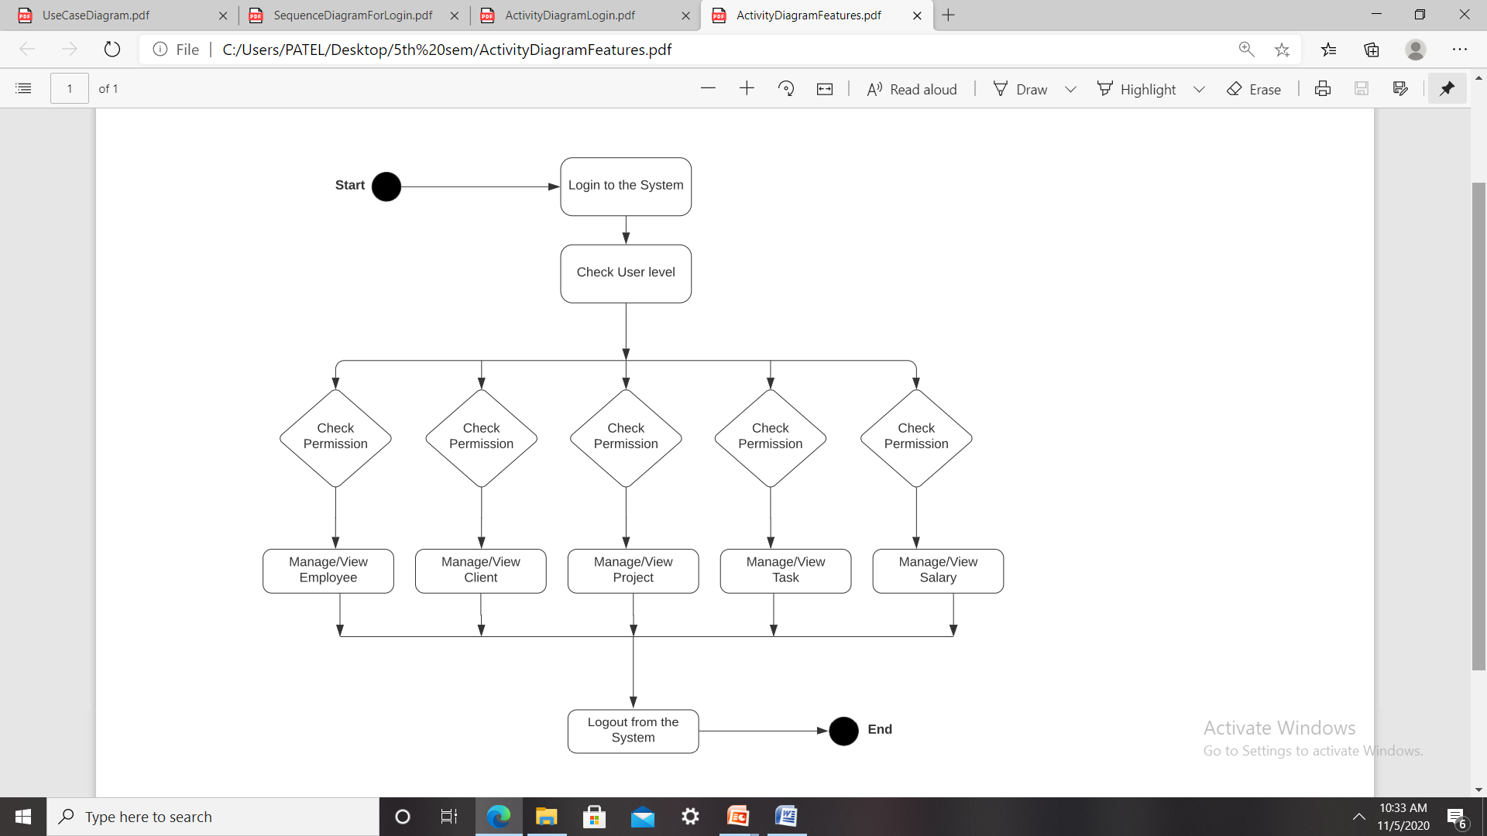
ACTIVITY DAIGRAM-FEATURES

Slide 15
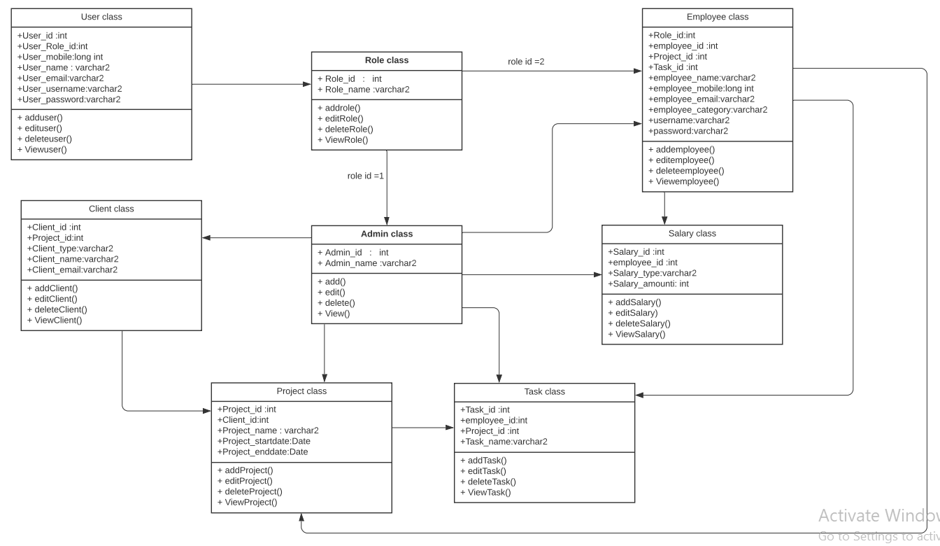
CLASS DIAGRAM

Slide 16
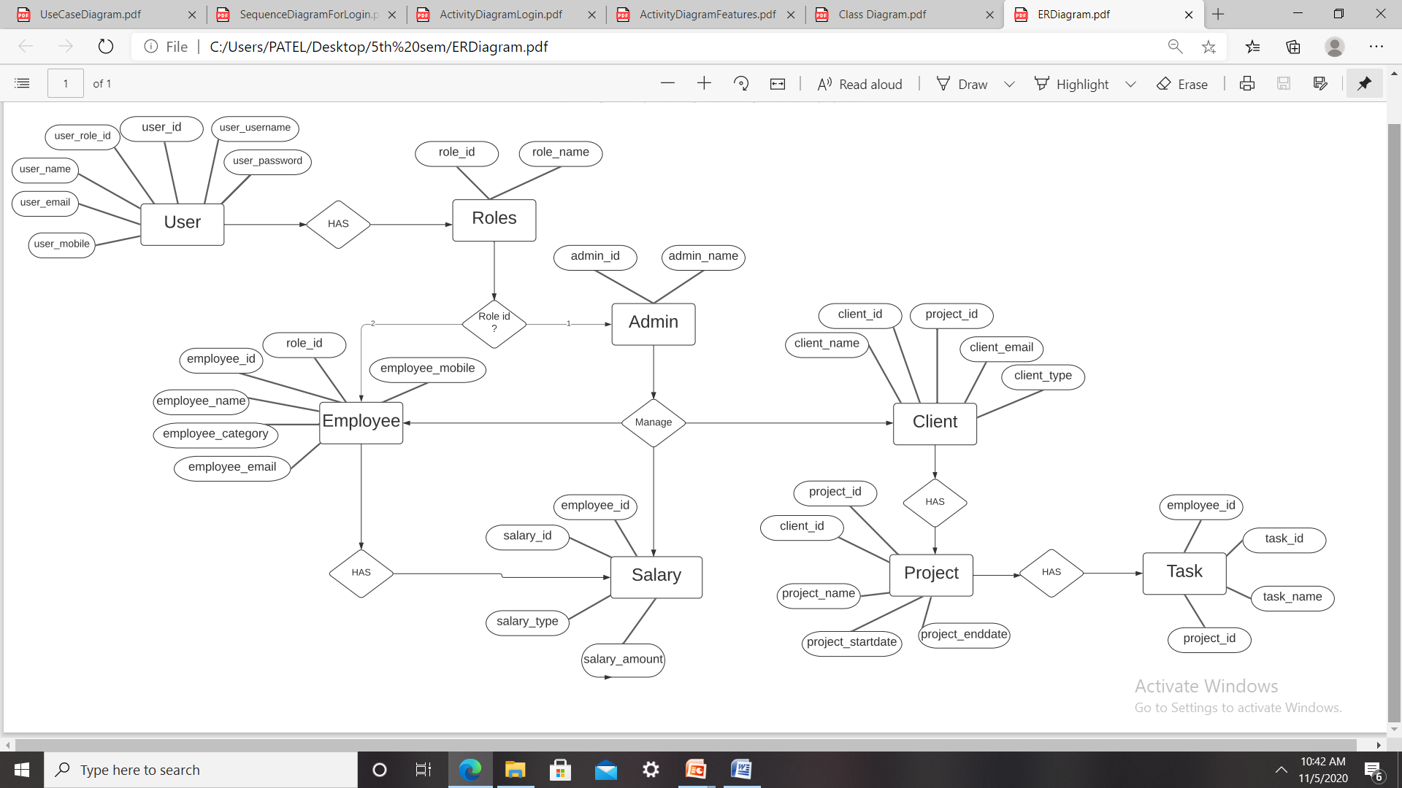
ER DIAGRAM

Slide 17
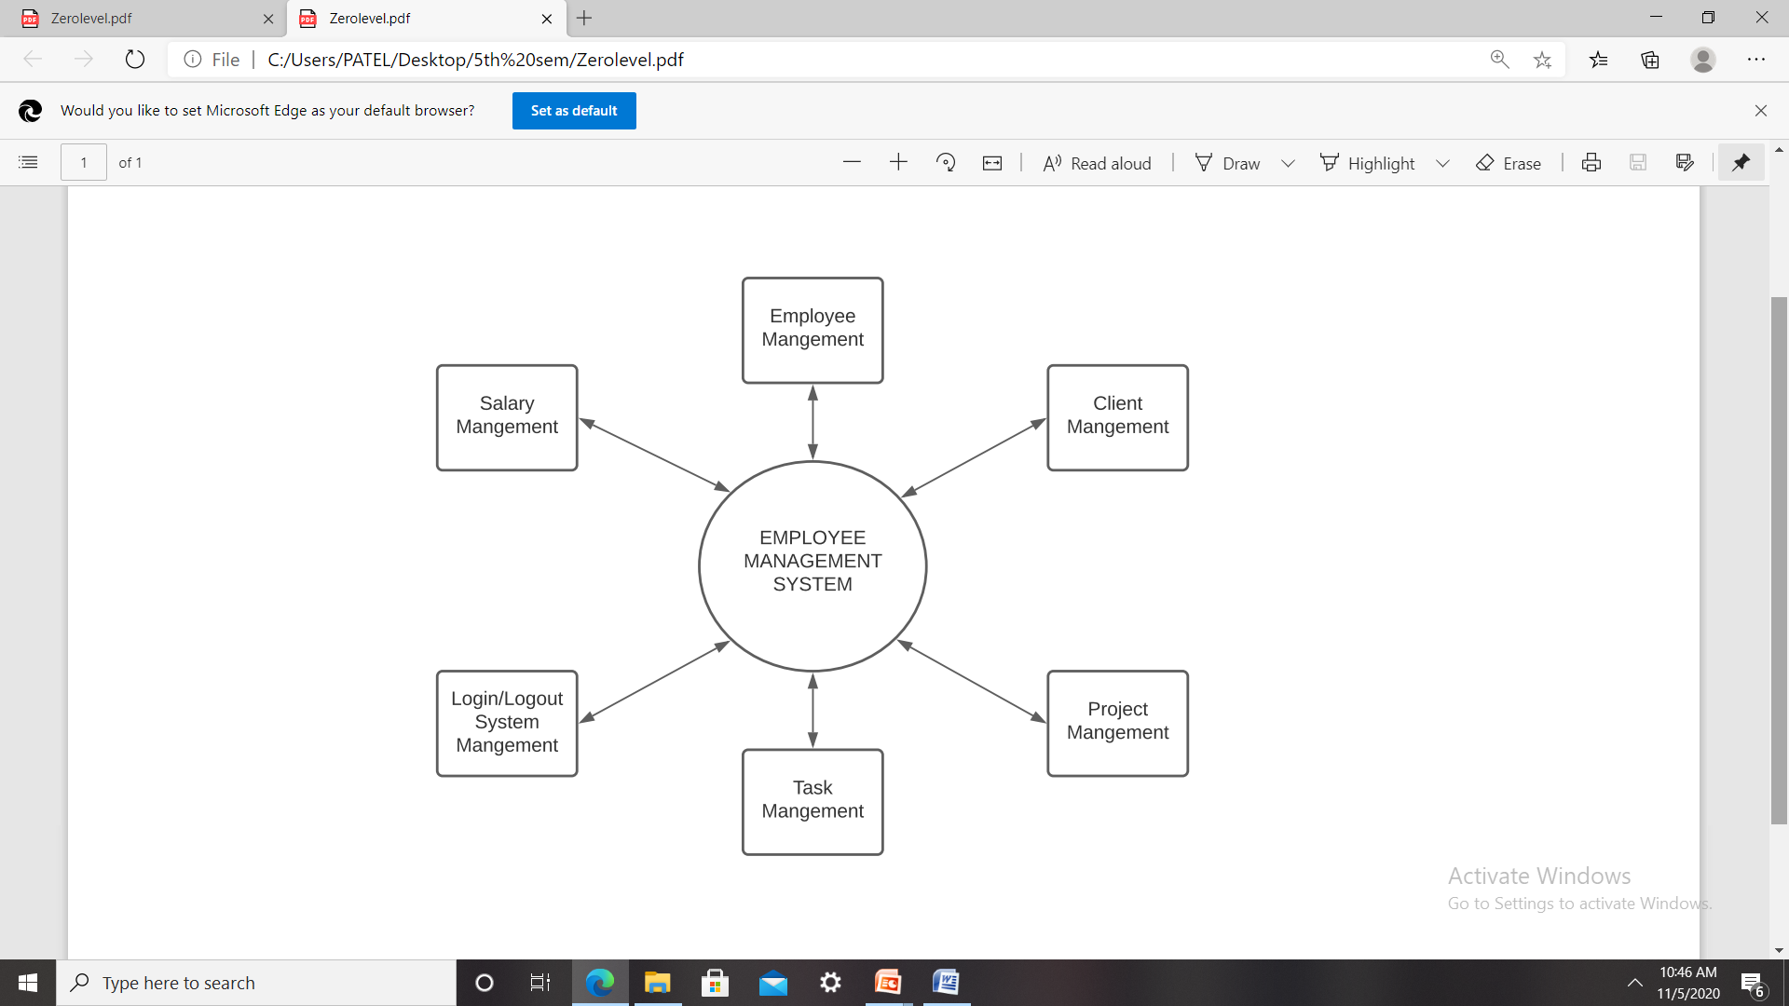
DATA FLOW DIAGRAM-ZERO LEVEL

Slide 18
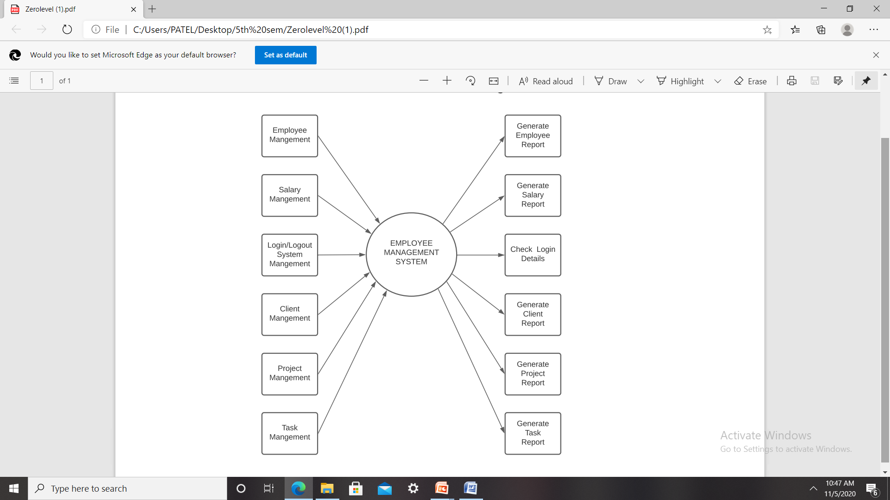
FIRST LEVEL DFD

Slide 19
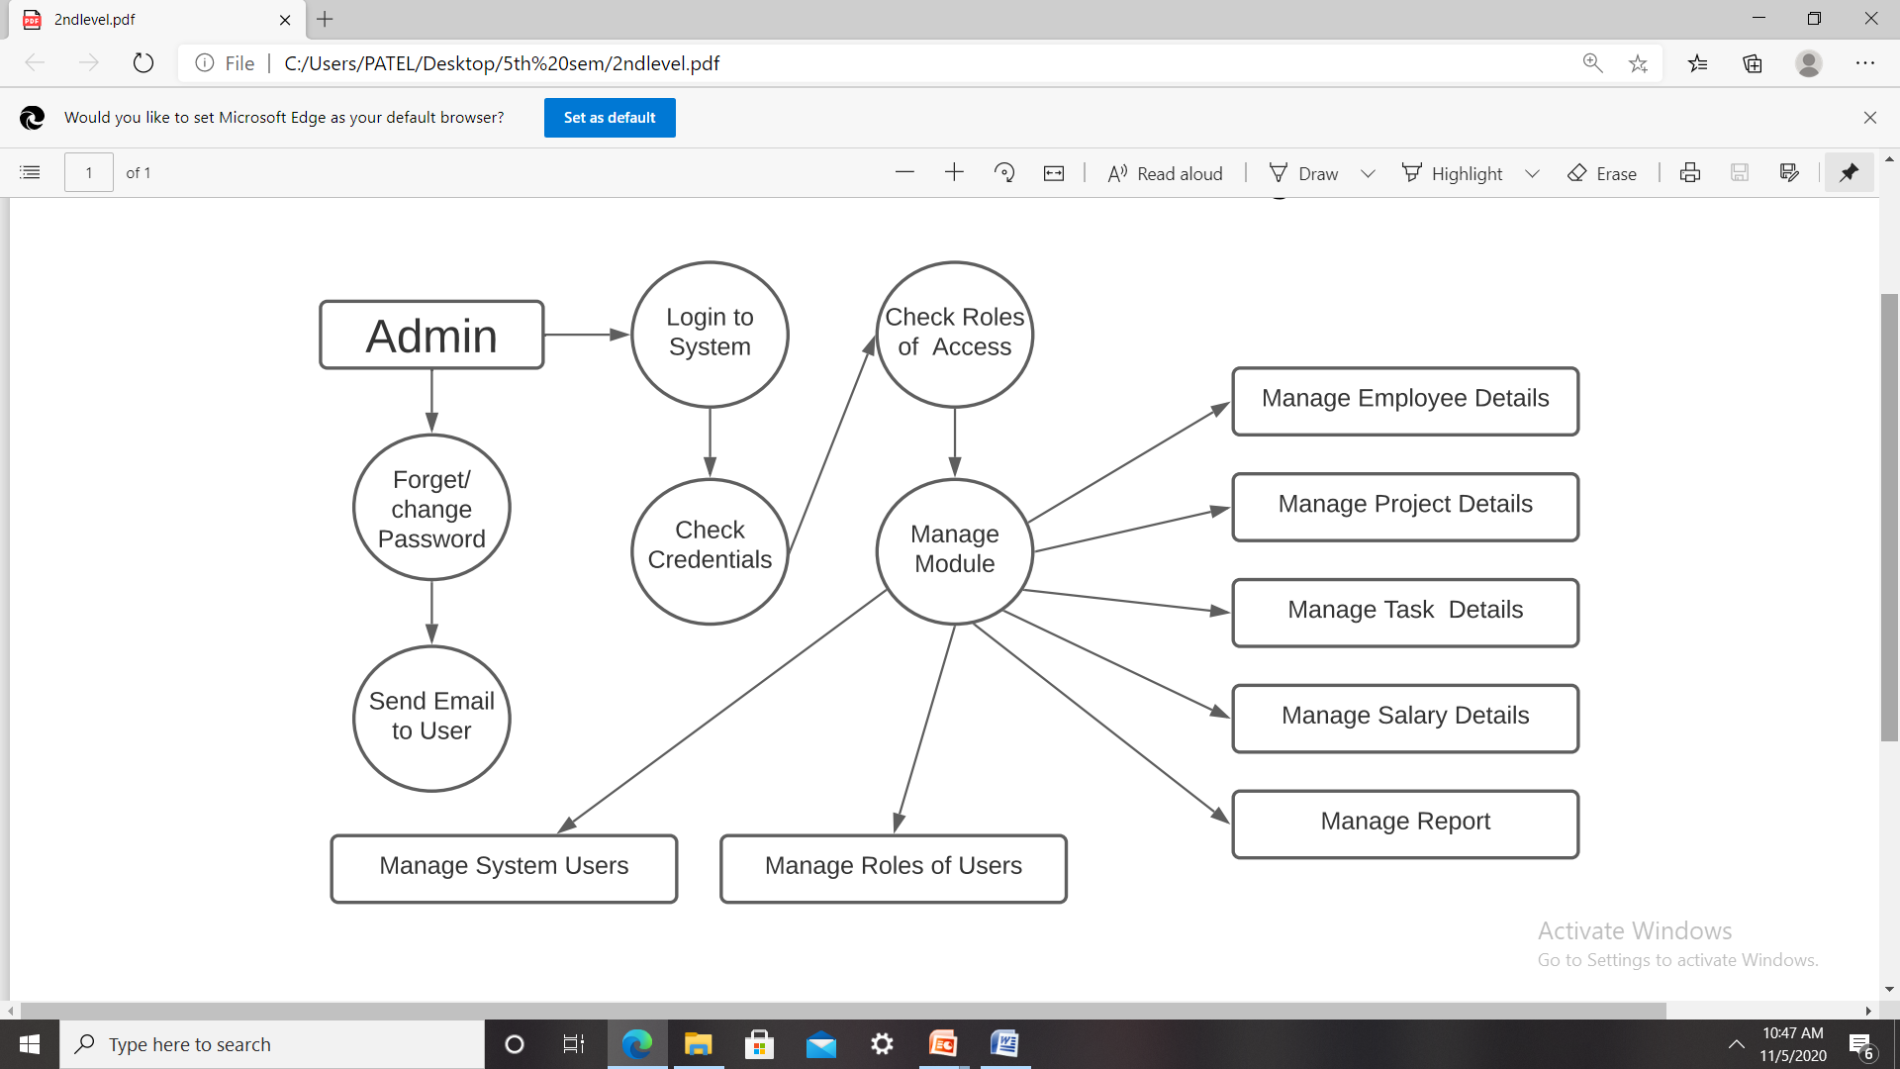
SECOND LEVEL DFD

Slide 20
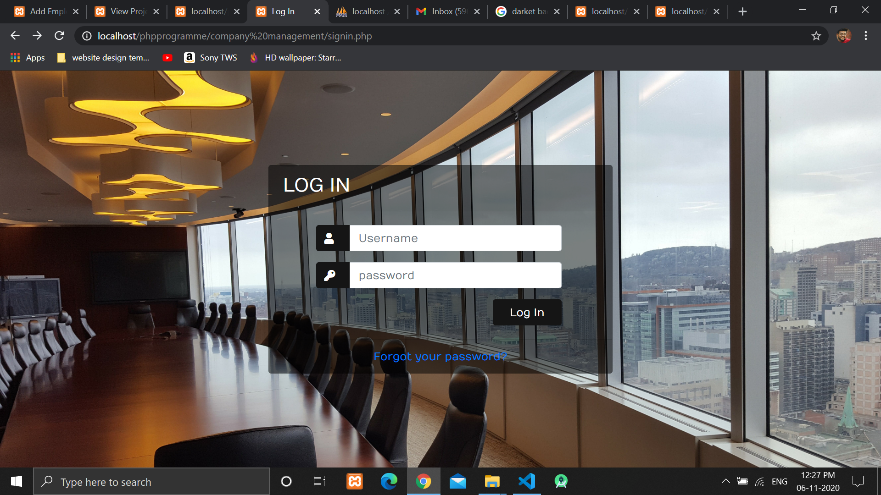
SCREENSHOTS OF THE PROJECT

Slide 21
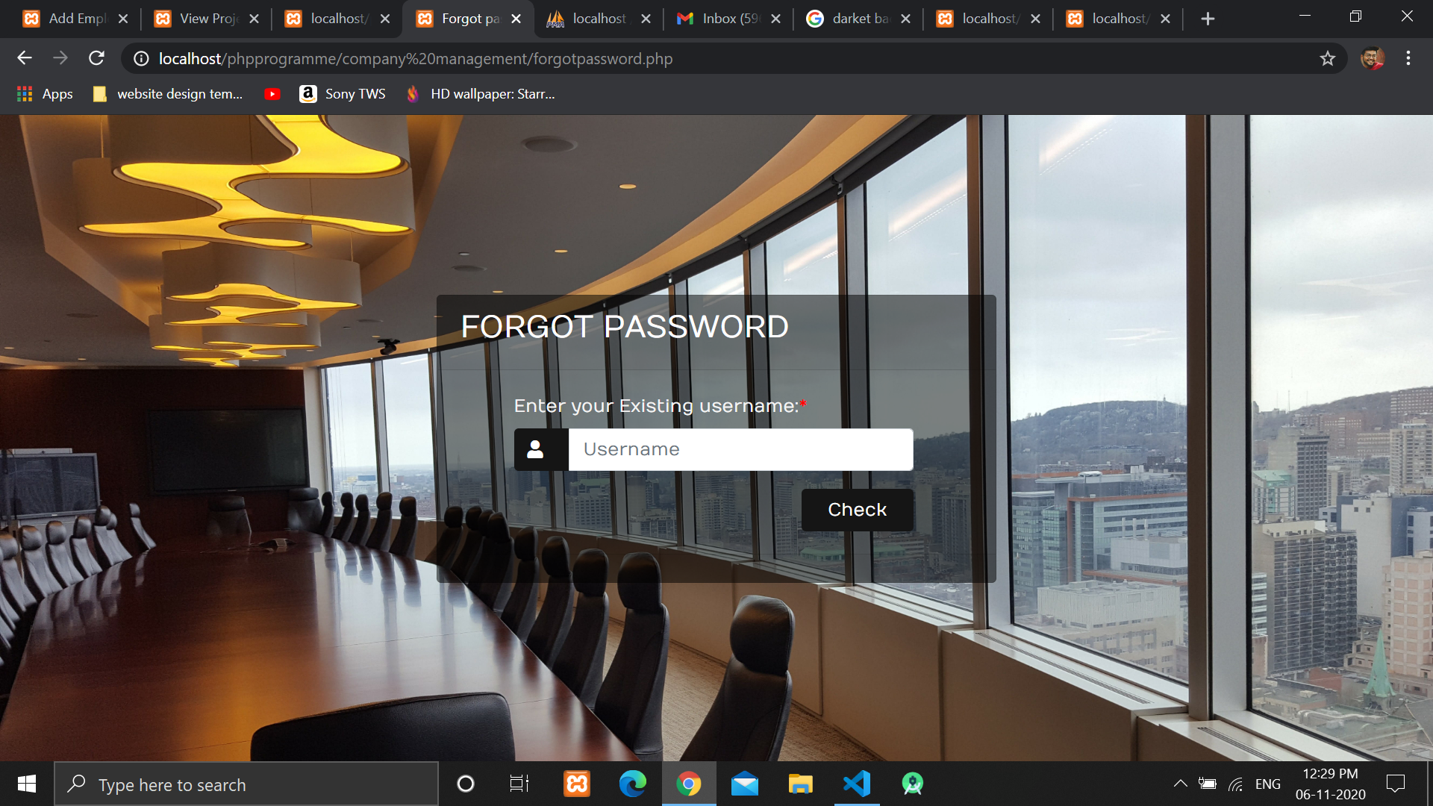

Slide 22
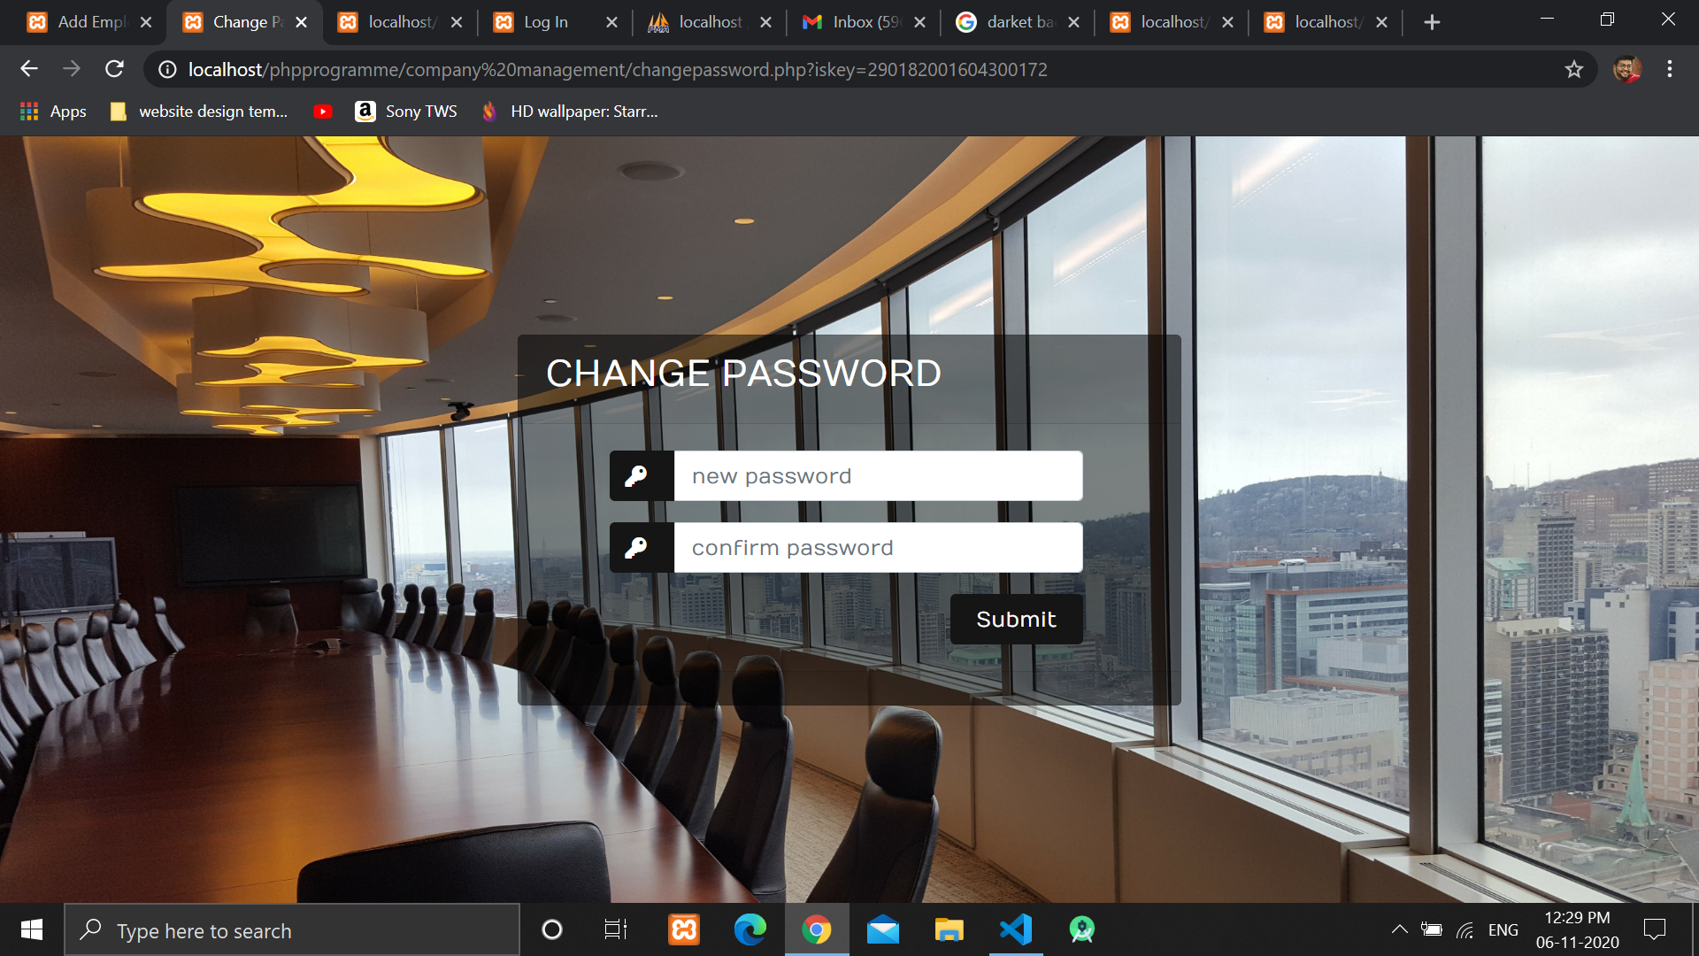

Slide 23
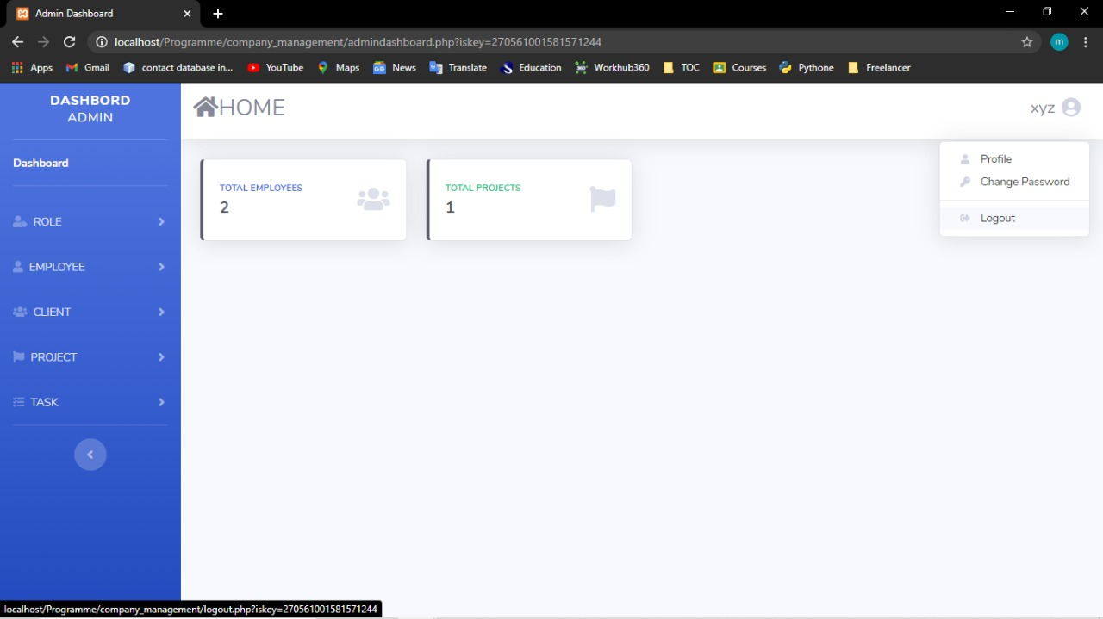

Slide 24
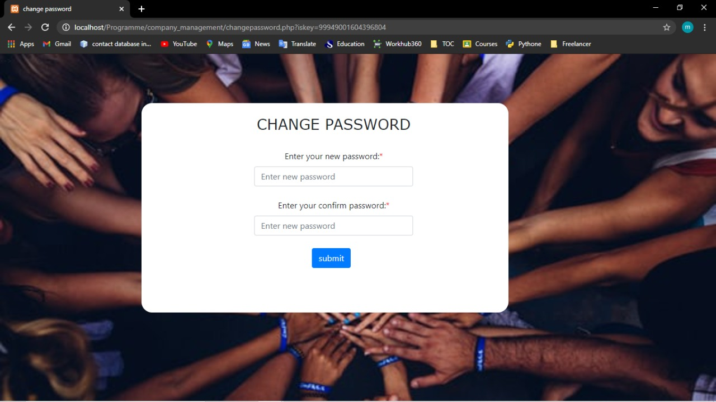

Slide 25
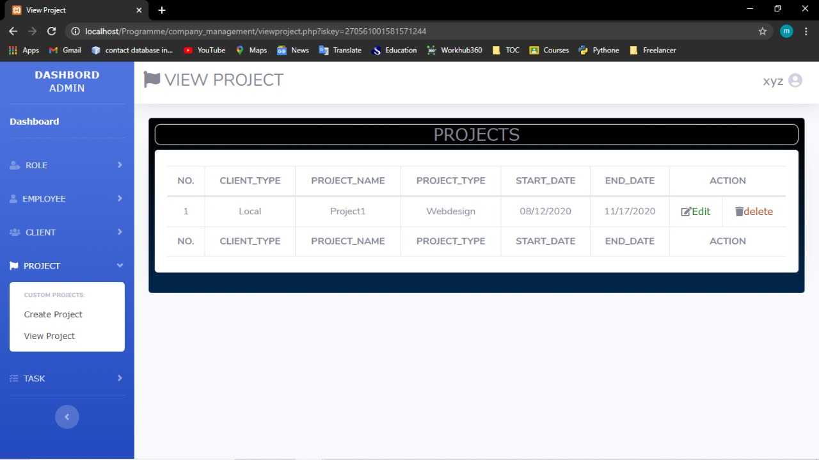

Slide 26
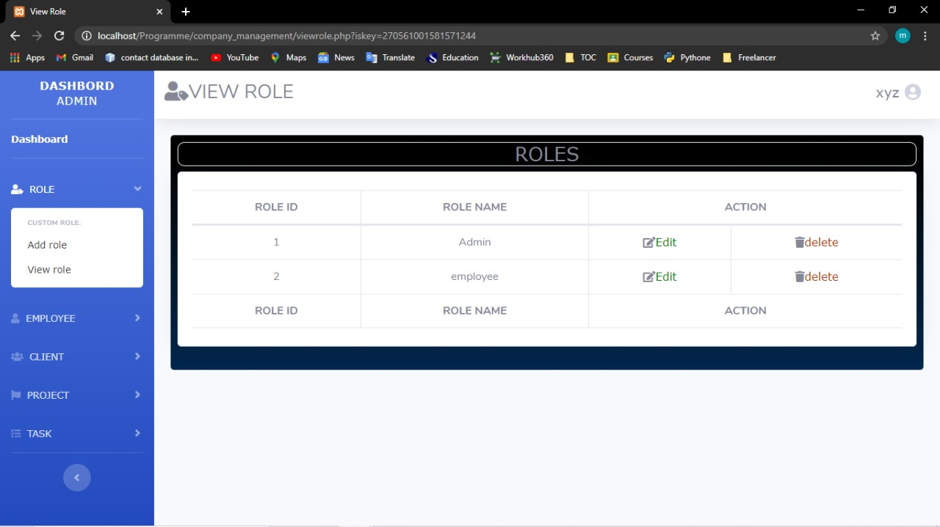

Slide 27
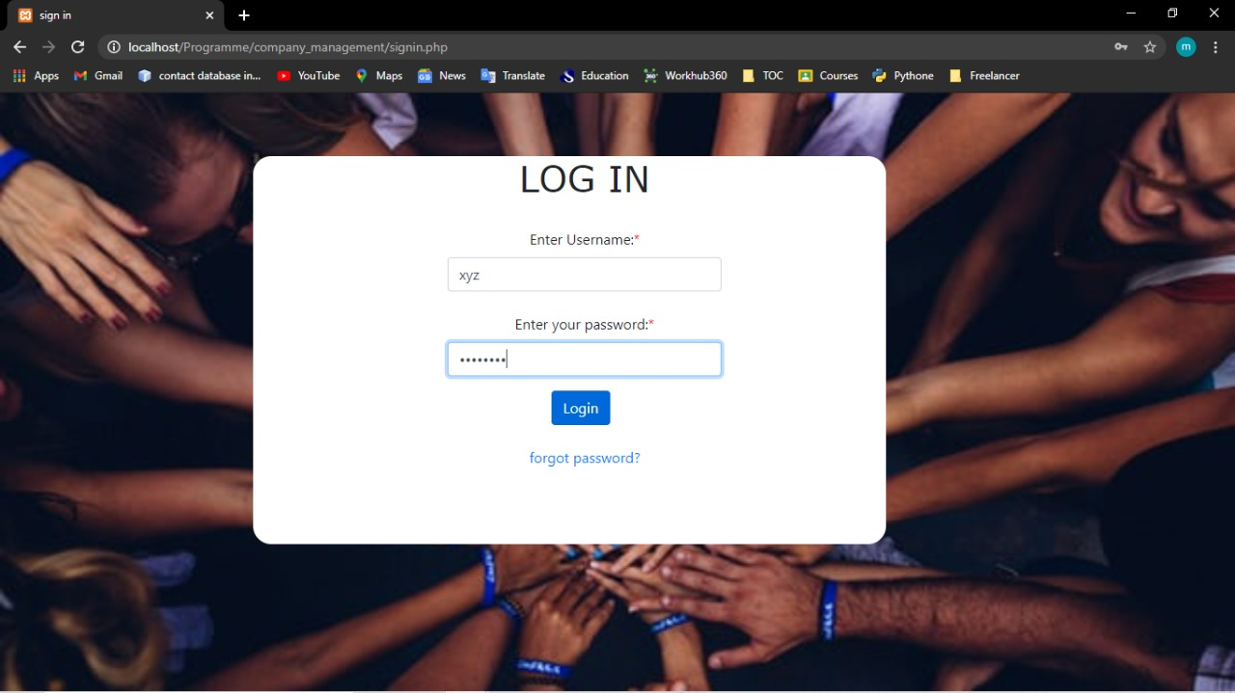

Slide 28
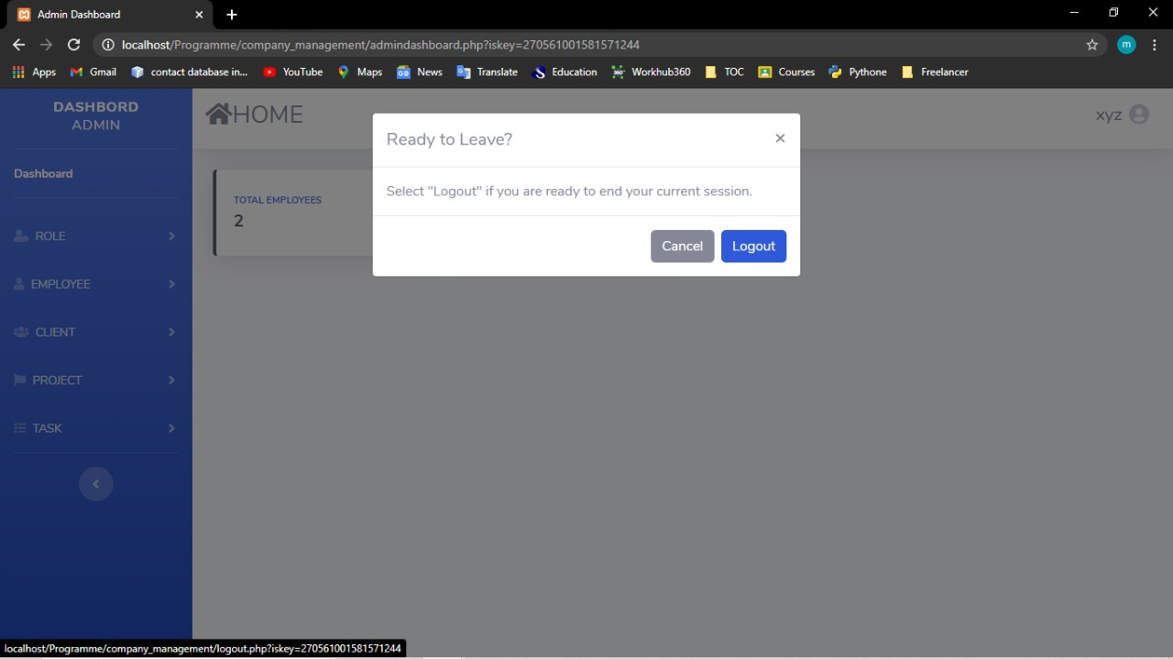

Slide 29
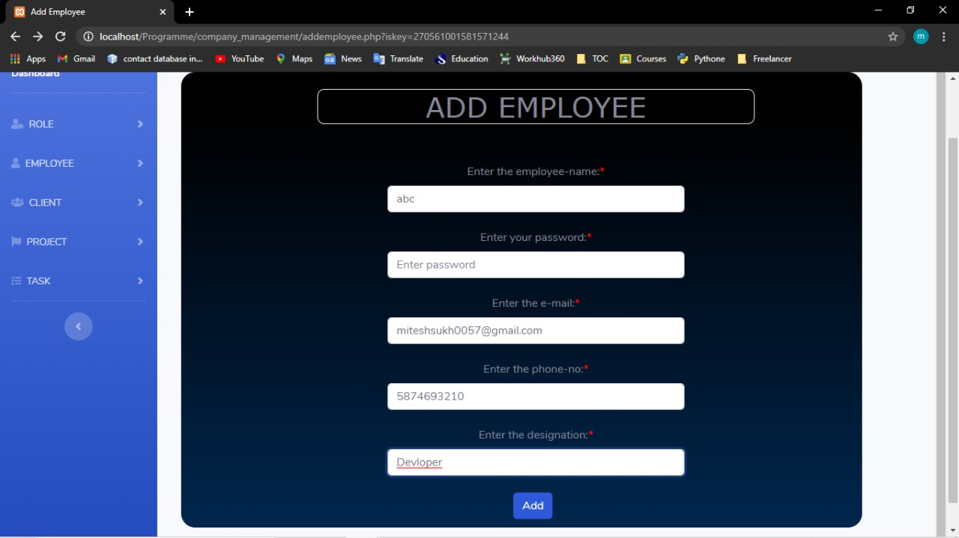

Slide 30
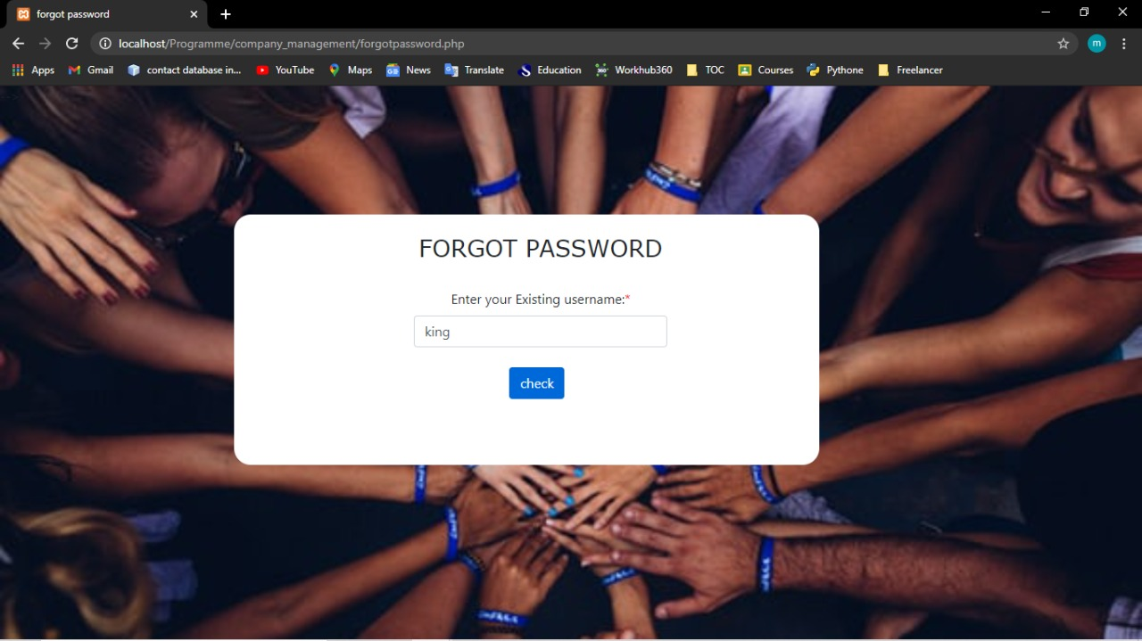

Slide 31
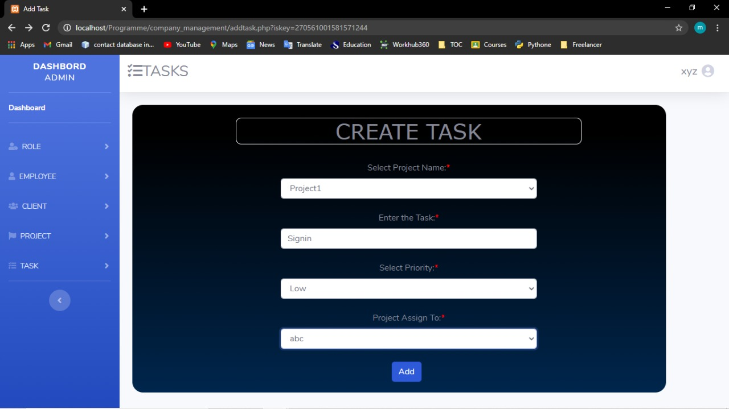

Slide 32
THANKYOU

